Slide 1
Introduction
-Sweedle Machado

Slide 2
Digital Signal and Image Processing

Slide 3
Digital Signal and Image Processing

Slide 4
What is signal?
Anything which carries information is a signal.
Examples of signals are:
human voice,
chirping of birds,
smoke
image,
gestures (sign language),
fragrances of the flowers.

Slide 5
1-D signal
A signal is function of one or more real variable(s)
When the function depends on a single variable, the signal is said to be one dimensional.
Eg: A speech signal, daily maximum temperature

Slide 6
Multidimensional Signals
When the function depends on two or more variables, the signal is said to be multidimensional.
Eg: An image is representing the two dimensional signal, vertical and horizontal coordinates representing the two dimensions.
Our physical world is four dimensional(three spatial and one temporal).

Slide 7
Digital Signal Processing

Slide 8
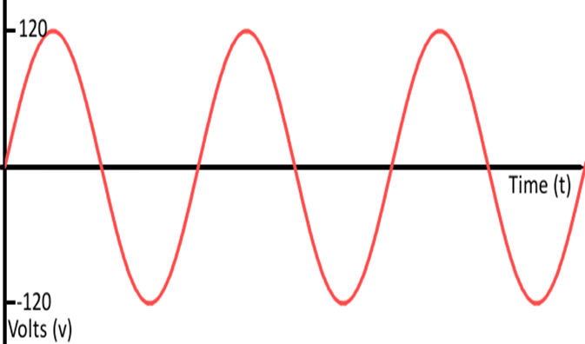
Analog Signals
An analog signal is a continuous wave denoted by a sine wave and may vary in signal strength (amplitude) or frequency (time).
Analog waves are smooth and continuous
Example: The sound from a human voice is analog.

Slide 9
Digital Signal
Described as using binary (0s and 1s), and therefore, cannot take on any fractional values.
A digital signal has a discrete value at each sampling point.
Digital signals must have a finite set of possible values
Eg: Digital waves are stepping, square, are discrete.

Slide 10
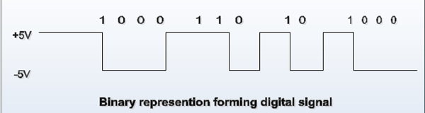
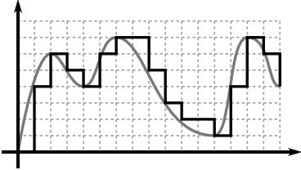

Slide 11
Analog signal
Digital Signal
Continuous signal
Information is translated into electric pulses of varying amplitude
Defined at all time instants
Eg: Sinusoidal, exponential,ECG,Speech
Discrete signal
Information is translated into binary format( 0 or 1)
Defined at some time instants

Slide 12
Why Digital not Analog?
We cannot store analog data.
Analog computers can't be easily reconfigured.
Noise.

Slide 13
Digital Signal Processing

Slide 14
Signal Processing
Processing means performing some operations on a signal to extract some useful information.
Eg: When we hear , we use our ears and auditory path ways in the brain to extract the information.
The signal processor may be an electronic system, a mechanical system or even it might be a computer program.

Slide 15
Digital Signal Processing

Slide 16
Digital signal processing
Digital signal processing means that the processing is done either by a digital hardware or by a digital computer.

Slide 17
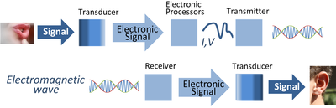

Slide 18
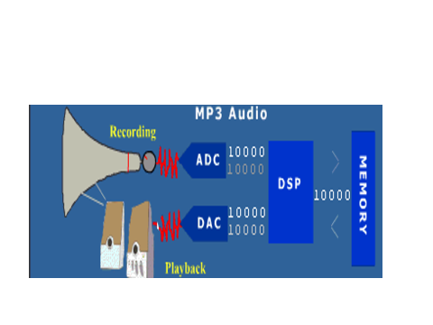

Slide 19
Applications of DSP
TV
Music Systems
Toys
Voice mail
Text to speech
Mobile
Radar
Sonar
Robots

Slide 20


